Slide 1
Context-Free Languages and Grammars

Slide 2
Learning Objectives
Learn what context-free behavior is.
Learn how context-free grammars can derive languages that are not regular.
Learn to construct linear context-free grammars.
Learn to construct non-linear context-free grammars.
Learn to construct leftmost and rightmost derivation trees for strings.
Learn the relationship between parsing and ambiguity in grammars.
Learn to eliminate ambiguity in grammars.
Learn to convert a context-free grammar to Chomsky Normal Form.
Learn to convert a context-free grammar to Greibach Normal Form.
Learn to parse a string using the CYK algorithm.

Slide 3
Learning Objectives
Learn how to add memory to a finite automaton.
Learn the equivalence of stack memory and context-free behavior.
Learn to construct a pushdown automaton for a context-free language.
Learn to convert a context-free grammar to a pushdown automaton.
Learn to convert a pushdown automaton to a context-free grammar.
Understand why non-determinism is required in pushdown automata.

Slide 4
The Idea of Context-Free Behavior
In linguistics, context refers to the relevant constraints of the communicative situation, both verbal and social, that influence language use, language variation and discourse.
For us, context usually means the surrounding text, that is, what appears before and what appears after the current (set of) symbol(s) in the input string.
Context-free means being able to take an action irrespective of the context, that is, irrespective of the surroundings.
A grammar is called context-free (CFG) if the application of a production rule for parsing or derivation is independent of the context in the sentential form where it is applied.
If a variable A occurs in the sentential form, it can be expanded using any production whose left-hand side is A irrespective of what terminal or variable is to the left or right of A in the present sentential form (and, indirectly, in the input string).
Every production rule must have only one non-terminal (and nothing else) on its left-hand side.

Slide 5
Context-Free Grammars
Many useful languages are not regular
Context-free grammars are very useful for the definition and processing of programming languages
A context-free grammar has no restrictions on the right side of its productions, while the left side must be a single variable
A language is context-free if it is generated by a context-free grammar
Since regular grammars are context-free, the family of regular languages is a proper subset of the family of context-free languages

Slide 6
Context-Free Languages
Consider the grammar
V = { S }, T = { a, b }, and productions
S → aSa | bSb | λ
Sample derivations:
S ⇒ aSa ⇒ aaSaa ⇒ aabSbaa ⇒ aabbaa
S ⇒ bSb ⇒ baSab ⇒ baab
The language generated by the grammar is
{ ww^{R}: w ∈ { a, b }*}
(in other words, even-length palindromes in { a, b }*)

Slide 7
Context-Free Languages
Consider the grammar
V = { S }, T = { a, b }, and productions
S → aSb | SS | λ
Sample derivations:
S ⇒ aSb ⇒ aaSbb ⇒ aabb
S ⇒ SS ⇒ aSbS ⇒ abS ⇒ abaSb ⇒ abab
The language generated by the grammar is
{ w ∈ { a, b }*: n_{a}(w) = n_{b}(w) and n_{a}(v) ≥ n_{b}(v) }
(where v is any prefix of w)

Slide 8
Leftmost and Rightmost Derivations
In a leftmost derivation, the leftmost variable in a sentential form is replaced at each step
In a rightmost derivation, the rightmost variable in a sentential form is replaced at each step
Consider the grammar from example 5.5:
V = { S, A, B }, T = { a, b }, and productions
S → aAB
A → bBb
B → A | λ
The string abb has two distinct derivations:
Leftmost: S ⇒ aAB ⇒ abBbB ⇒ abbB ⇒ abb
Rightmost: S ⇒ aAB ⇒ aA ⇒ abBb ⇒ abb

Slide 9
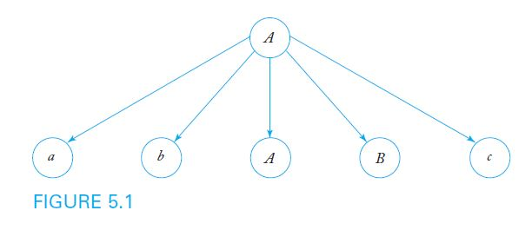
Derivation Trees
In a derivation tree or parse tree,
the root is labeled S
internal nodes are labeled with a variable occurring on the left side of a production
the children of a node contain the symbols on the corresponding right side of a production
For example, given the production A → abABc, Figure 5.1 shows the corresponding partial derivation tree

Slide 10
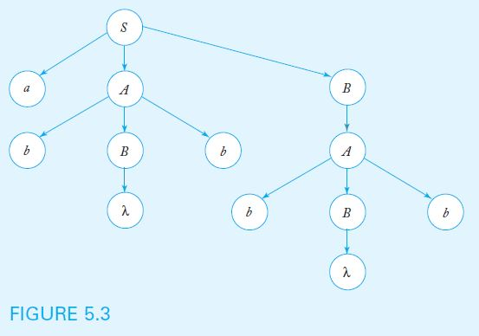
Derivation Trees (Cont.)
The yield of a derivation tree is the string of terminals produced by a leftmost depth-first traversal of the tree
For example, using the grammar from example 5.5, the derivation tree below yields the string abbbb

Slide 11
Sentential Forms and Derivation Trees
Theorem 5.1 states that, given a context-free grammar G, for every string w in L(G), there exists a derivation tree whose yield is w
The converse is also true: the yield of any derivation tree formed with productions from G is in L(G)
Derivation trees show which productions are used in obtaining a sentence, but do not give the order of their application

Slide 12
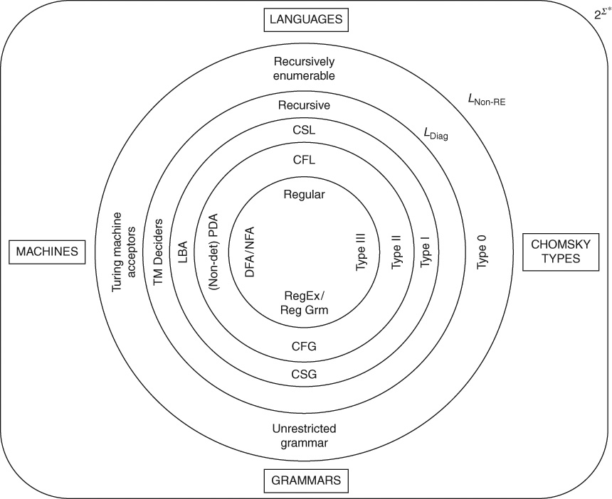
Chomsky Hierarchy

Slide 13
Non-Context-Free Grammars
If a variable can only be expanded in a given context
If the context is encoded on the left-hand side of the production rule
E.g., aS → aaSb can be applied only if the S is preceded by an a
Such grammars are called context-sensitive grammars (see Chapter 11)

Slide 14
Context-Free Grammars
Every regular grammar is context-free, but
Not every context-free grammar is regular
It may not be right-linear or left-linear, i.e., it may have a variable in the middle of the right-hand side of the grammar, surrounded by terminal symbols on both sides
E.g., S → aSb | λ
It may not even be linear, i.e., may have more than one variable on the right-hand side

Slide 15
CFG: Example
Even number of a s followed by even number of b s: (aa)*(bb)*
S → aaS | Sbb | aaSbb | λ
This is a CFG but is not regular
An equivalent right-linear grammar (since this is a regular language) is:
S → aaS | A
A → bbA | λ

Slide 16
Context-Free Languages
What is the language of a CFG that is not regular?
The language of a grammar is the set of all strings over its alphabet which can be derived or generated from the start symbol S of the grammar, or,
The same set of grammatically correct strings which can be parsed using the grammar to construct a parse tree with S as its root and the input string along the leaves of the parse tree (which is also called the yield of the parse tree).
The language of a CFG that is not a regular language is called a context-free language (CFL for short).
CFLs are a superset of the set of regular languages, that is, there are CFLs that are not regular.
One cannot construct a finite automaton or regular expression for a CFL that is not regular.

Slide 17
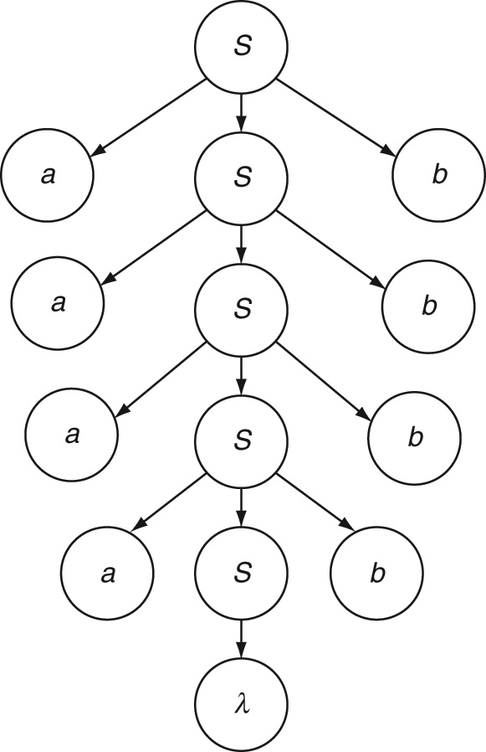
Linear CFG: Example 1
Simple nesting language a^{n}b^{n}
Observation: a^{n}b^{n} = aa^{n-1}b^{n-1}b
S → aSb | λ
Derivation for a⁴b⁴
Parse tree:

Slide 18

Linear CFG: Example
Even palindromes ww^{R}
S → aSa | bSb | λ
Derivation of: abbabbabba

Slide 19
Linear CFG: Examples
Example 2: Odd palindromes wcw^{R}
S → aSa | bSb | c
Example 3: One more b than a, i.e., a^{n}b^{n+1}
S → aSb | b
Example 4: a s followed by twice as many b s, i.e., a^{n}b^{2n}
S → aSbb | λ
Example 5: a s followed by a lesser number of b s, i.e., a^{n}b^{m} n > m
S → aSb | aS | a

Slide 20
Linear CFG: Examples
Example 6: Unequal numbers of a s and b s
S → A | B
A → aAb | aA | a
B → aBb | Bb | b

Slide 21
Linear CFG: Language of Addition
Example 7: Language of addition a^{n}b^{m}c^{k} where k = n + m
Observation: a^{n}b^{m}c^{k} = a^{n}b^{m}c^{m}c^{n}
S → aSc | A
A → bAc | λ

Slide 22
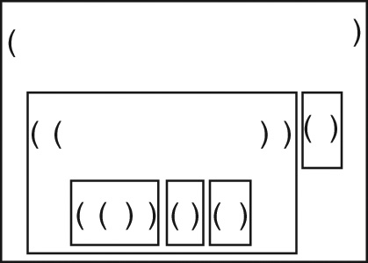
Non-Linear CFG: Example 8
Proper nesting language (parentheses matching)
The string must start with an o, that is, an opening parenthesis.
At any point, counting from left to right (i.e., in any prefix), the number of closing parentheses (i.e., c) encountered thus far cannot be greater than the number of opening parentheses (i.e., o).
The number of opening and closing parentheses must be equal at the end of the string.
S → oSc | SS | λ
Example: ((((())()()))()), that is, oooooccococccocc
Tree structure:

Slide 23

Non-Linear CFG: Example 9
Equal numbers of a and b in any order (n_{a} = n_{b})
S → aSb | bSa | SS | λ
Example: babbabaaaababb
Derivation:

Slide 24
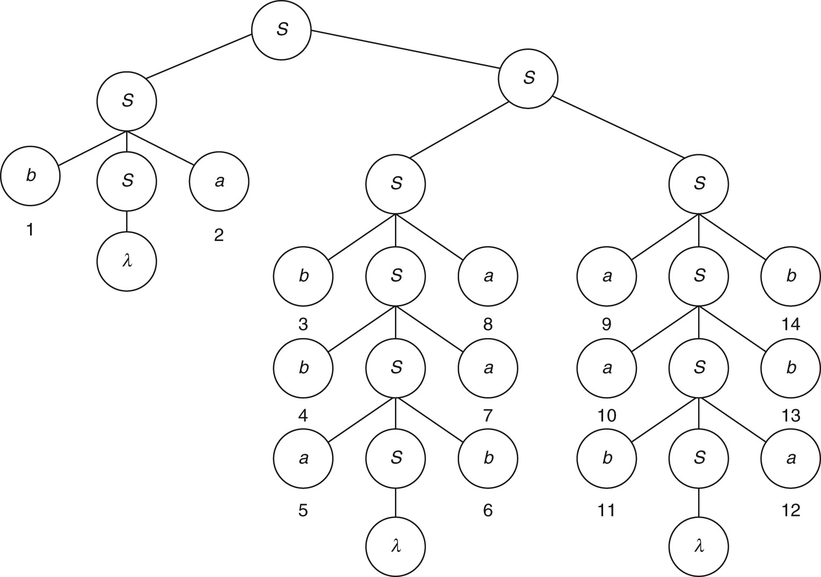
Parse Tree: Example 10

Slide 25
Non-Linear CFG: Example 11
Unequal numbers of a and b in any order
S → A | B
A → aAb | bAa | AA | a | aA | Aa
B → aBb | bBa | BB | b | bB| Bb

Slide 26
Non-Linear CFG: Nested If-Then-Else
Example 12:
Σ = {if, condition, then, else, statement, \{, \} }
An example string in the language is as follows:
If condition then statement else { if condition then statement else statement }
CFG:
S → if condition then S
S → if condition then S else S
S → { S }
S → statement

Slide 27

Non-Linear CFG: Arithmetic Expressions
Example 13: Σ = { variable, constant, +, -, *, /, (, ) }
S → S + S
S → S * S
S → S – S
S → S / S
S → (S)
S → variable | constant
Example: (x + 2.0) * y / (z – 6.0)
Derivation:

Slide 28
Summary for CFGs
In addition to mantras for regular grammars (Chapter 5):
Since CFGs have the ability to generate strings with a tree structure, we need not be constrained by left-to-right processing of strings. Thinking in terms of parse trees and actually constructing parse trees for a few sample strings in the language will help in writing a suitable grammar.
As we will see in Chapter 9, CFLs have two parts in their strings that are correlated with one another. For example, the number of opening parentheses must match the number of closing parentheses. Figure out what is the correlation in the given language. To model such correlated behaviors, CFGs can add corresponding elements in two places in the string being generated by having non-regular productions (i.e., rules of the form S … S ... where the variable is in the middle of the right-hand side).
CFGs can also be non-linear, that is, they can have more than one variable on the right-hand side of a production rule. This gives them the ability to concatenate sub-strings (or join sub-trees) each of which can be from its own CFL. A single non-linear production of the form S SS is often sufficient. If you determine that the given language is non-linear, apply the counting technique used in Example 7.12 to mark the boundaries of the sub-strings to be concatenated. This will help in separating the linear and non-linear parts of the grammar.

Slide 29
Summary for CFGs (contd..)
It is often useful to compare the given language to one of the known CFLs such as the languages of simple nesting, proper nesting, addition, if-then-else and arithmetic expressions. Differences, if any, can be accommodated by modifying the production rules appropriately.
CFLs usually have some parts that are regular as well, that is, in addition to their correlated context-free behaviors, strings in the language contain parts that can be modeled using regular expressions. For example, one or more extra symbols (i.e., a^{n}b^{n + 1}), some symbols in the middle (i.e., odd palindromes) and so on. Figuring out these will ease the construction of suitable productions (which by themselves tend to be right or left-linear) for modeling the regular parts of the language.

Slide 30
Parsing and Membership
The parsing problem: given a grammar G and a string w, find a sequence of derivations using the productions in G to produce w
Can be solved in an exhaustive, top-down, but not very efficient fashion
Theorem : Exhaustive parsing is guaranteed to yield all strings eventually, but may fail to stop for strings not in L(G), unless we restrict the productions in the grammar to avoid the forms A → λ and A → B

Slide 31
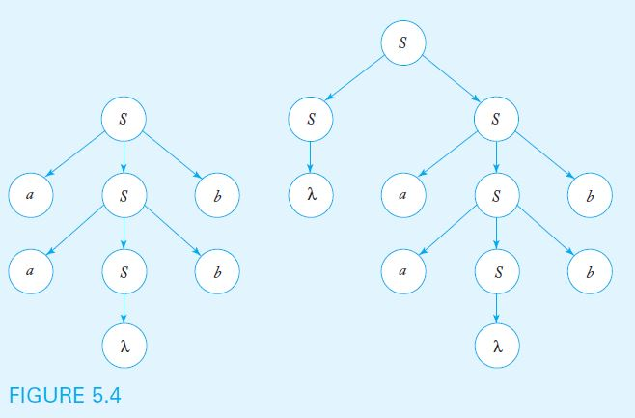
Parsing and Ambiguity
A grammar G is ambiguous if there is some string w in L(G) for which more than one derivation tree exists
The grammar with productions S → aSb | SS | λ is ambiguous, since the string aabb has two derivation trees, as shown below

Slide 32
Ambiguity in Programming Languages
Consider the grammar below, designed to generate simple arithmetic expressions such as (a+b)*c and a*b+c
V = { E, I }, T = { a, b, c, +, *, (, ) }, and productions
E → I
E → E+E
E → E*E
E → (E)
I → a | b | c
The grammar is ambiguous because strings such as a+b*c have more than one derivation tree, as shown in Figure 5.5

Slide 33
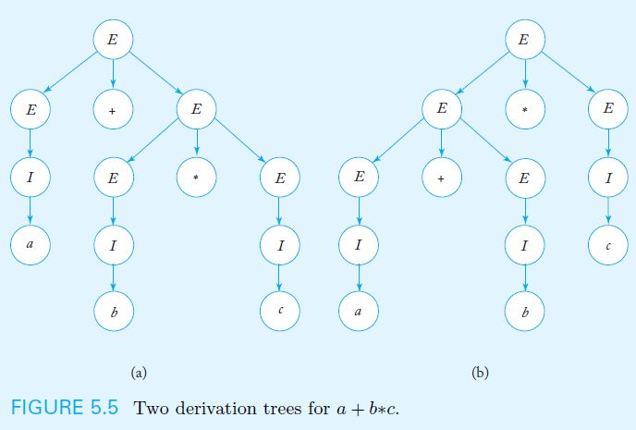
Derivation Trees from Ambiguous Grammar

Slide 34
Resolving Ambiguity
Ambiguity can often be removed by rewriting the grammar so that only one parsing is possible
Consider the grammar
V = { E, T, F, I }, T = { a, b, c, +, *, (, ) }, and productions
E → T
T → F
F → I
E → E+T
T → T*F
F → (E)
I → a | b | c
As shown in Figure 5.6, only one derivation tree yields the string a+b*c

Slide 35
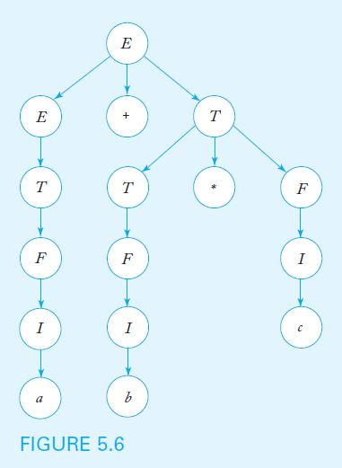
Derivation Tree for a+b*c Using Unambiguous Grammar

Slide 36
Ambiguous Languages
For some languages, it is always possible to find an unambiguous grammar, as shown in the previous example
However, there are inherently ambiguous languages, for which every possible grammar is ambiguous
Consider the language { a^{n}b^{n}c^{m} } ∪ { a^{n}b^{m}c^{m} }, which is generated by the grammar
S → S₁ | S₂
S₁ → S₁c | A
A → aAb | λ
S₂ → aS₂ | B
B → bBc | λ
The grammar above (and every other equivalent grammar) is ambiguous, because any string of the form a^{n}b^{n}c^{m} has two distinct derivations

Slide 37
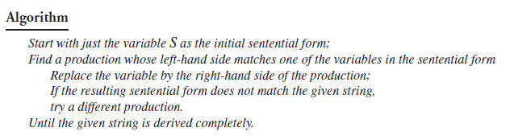
Parsing: Simple Algorithm

Slide 38

Ambiguity: Example (again)
Equal numbers of a and b in any order (n_{a} = n_{b})
S → aSb | bSa | SS | λ
Example: babbabaaaababb
Derivation:
Another derivation:

Slide 39
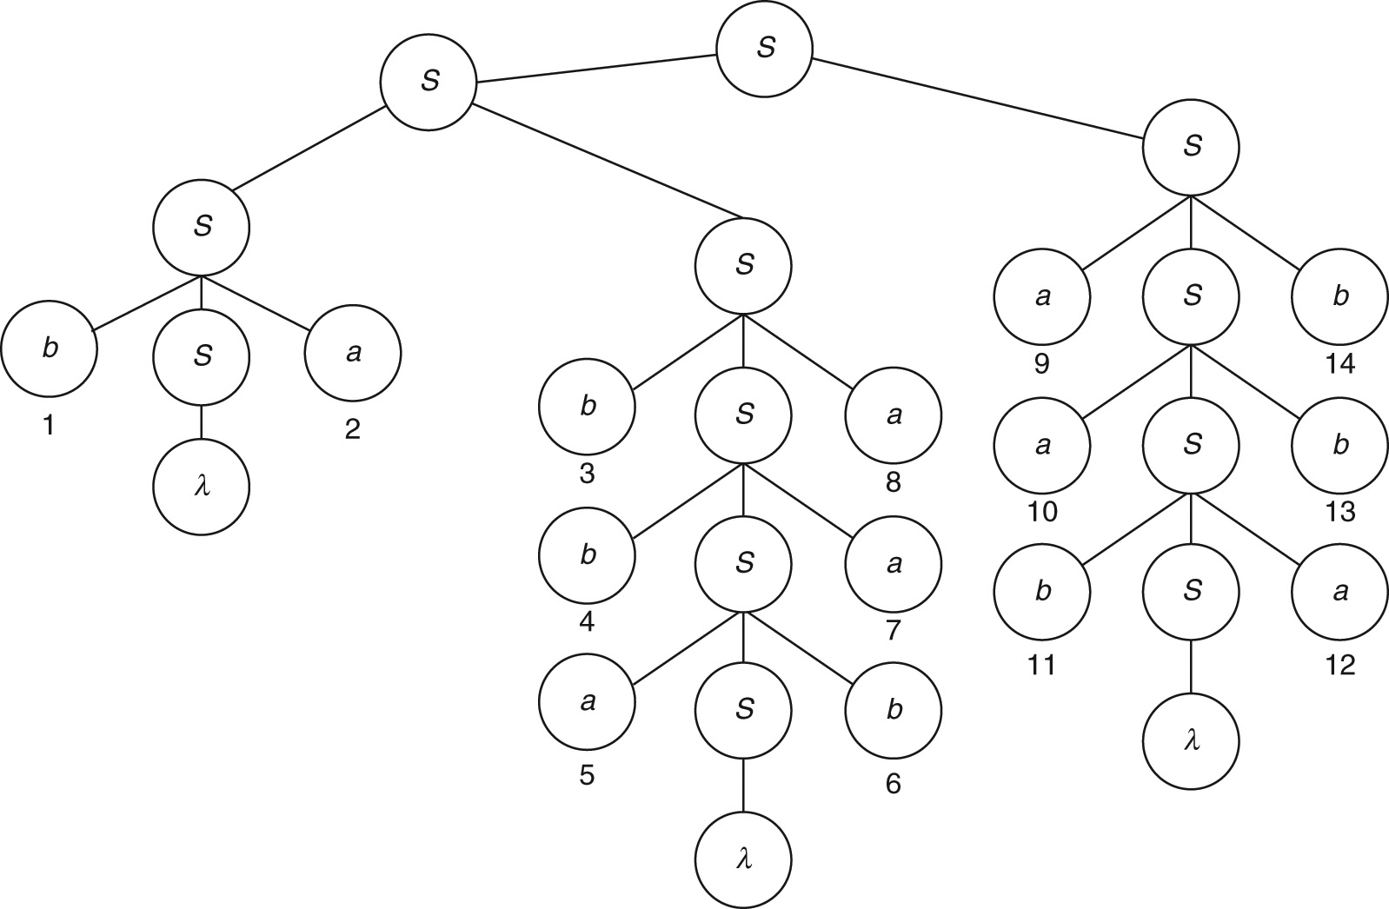
Ambiguity: Two Parse Trees

Slide 40
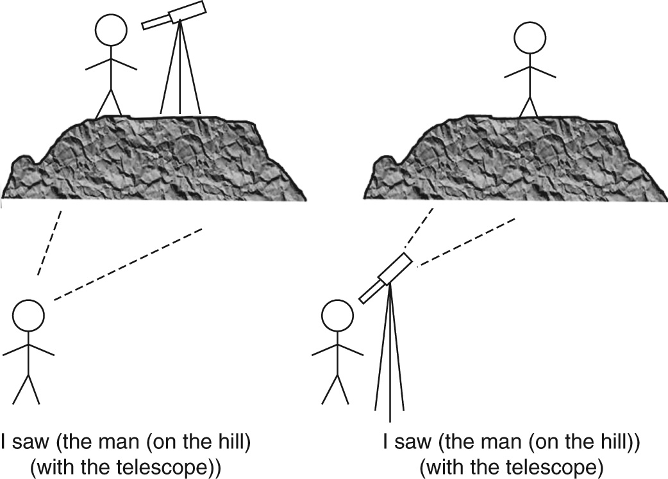
Ambiguity in Natural Language
I saw the man on the hill with the telescope.

Slide 41

Ambiguity in Expression Evaluation
Example 14: Σ = { variable, constant, +, -, *, /, (, ) }
S → S + S
S → S * S
S → S – S
S → S / S
S → (S)
S → variable | constant
Example 15: a + b/c with two leftmost derivations;

Slide 42
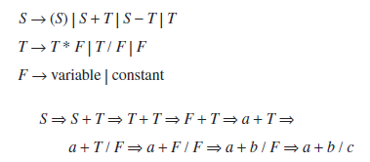
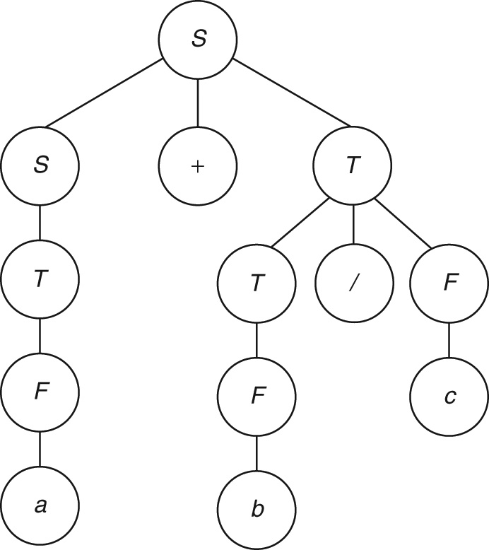
Eliminating Ambiguity: Example 16
Modified expression grammar
Grammar
Single leftmost derivation

Slide 43
The Idea of Chomsky Normal Form
Normal forms clean up a grammar
They make parsing efficient
Any CFG can be converted to Chomsky Normal Form
If the language includes the null string, it should be excluded
Chomsky Normal Form: every production is of one of the two forms:
A → a Replaces a variable in the sentential form by a terminal symbol
A → BC Replaces a variable by two variables to grow the sentential form
Idea: Binary parse tree
Idea: Each step in derivation either does not change the length of the sentential form or grows it by 1

Slide 44
Cleaning up a Grammar
Grammars in normal forms cannot have
Lambda productions of the form A → λ. Variables having such productions are called nullable variables.
Unit productions of the form A → B which merely replace one variable by another without making any progress in the derivation.
Useless variables which are of two kinds:
Non-generating ones which never lead to terminal symbols. If a non-generating variable is introduced into the sentential form, it is a dead-end; the sentential form can never generate any string in the language since there is no way to get rid of the non-generating variable.
Productions for unreachable variables. An unreachable variable, on the other hand, does not appear on the right-hand side of any production (to make it reachable from the start symbol S) and hence will never appear in a sentential form.

Slide 45
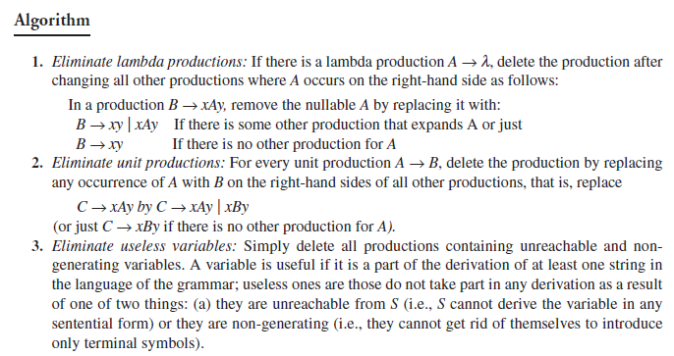
Converting to Chomsky Normal Form

Slide 46
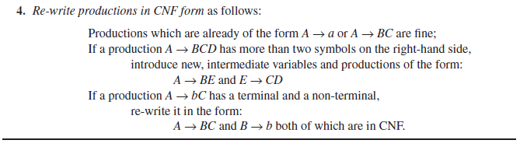
Converting to CNF (contd..)

Slide 47
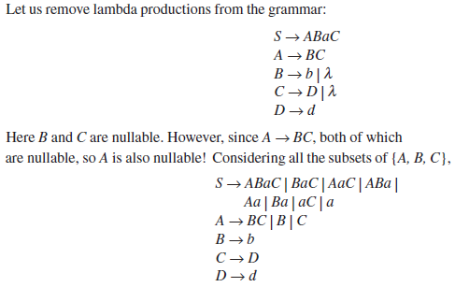
Removing Lambda Productions: Example 17

Slide 48
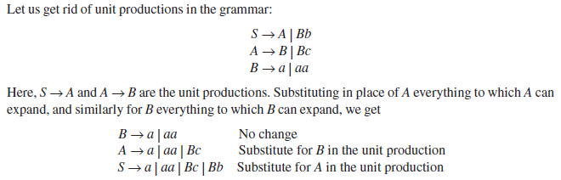
Removing Unit Productions: Example 18

Slide 49
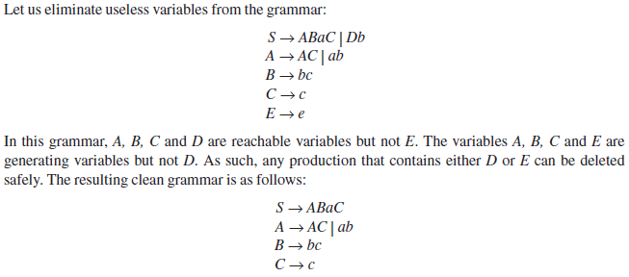
Removing Useless Variables: Example 19

Slide 50
Order of Steps in Converting to CNF
Eliminate lambda productions
Eliminate unit productions
Eliminate useless variables
Rewrite in Chomsky Normal Form
Remember: lambda units are useless

Slide 51
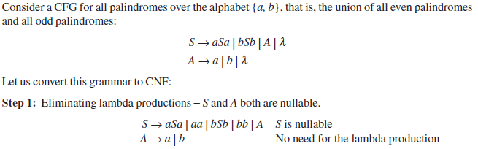
Converting to CNF: Example 20

Slide 52
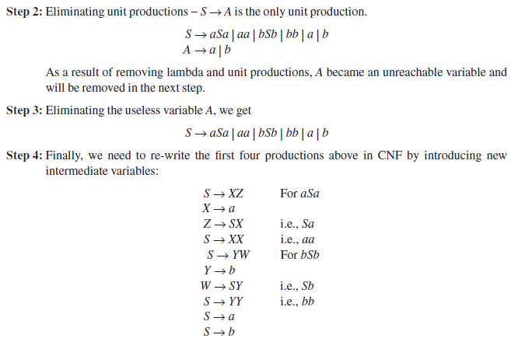
CNF: Example 21 (contd..)

Slide 53
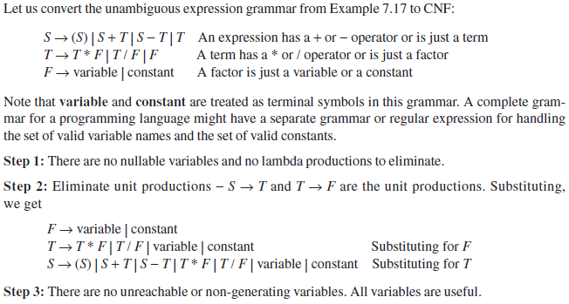
Converting to CNF: Example 22

Slide 54
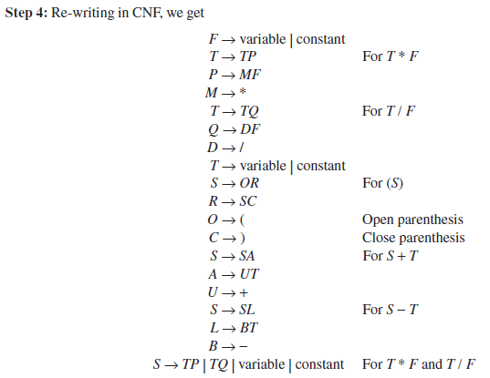
CNF: Example 22 (contd..)

Slide 55

Parsing with CNF: CYK Algorithm
The algorithm described here is called the CYK algorithm, after its originators J. Cocke, D.H. Younger, and T. Kasami.
The algorithm works only if the grammar is in Chomsky normal form and succeeds by breaking one problem into a sequence of smaller ones in the following way.
Assume that a grammar G = (V, T, P, S) is in Chomsky normal form and a string
w = a₁ a₂…a_{n}.
Substrings are defined as
w_{ij} = a_{i}..a_{j}
and subsets of V as
Clearly, w ∈ L(G) if and only if S ∈ V_{1n}.

Slide 56


Parsing with CNF: CYK Algorithm
To compute V_{ij}, observe that A ∈ V_{ii} iff G contains a production A → a_{i}.
Therefore, V_{ii} can be computed for all 1 ≤ i ≤ n by inspection of w and the productions of the grammar.
To continue, notice that for j > i, A derives w_{ij} if and only if there is a production A → BC, with and for some k with i ≤ k, k < j.
In other words,

Slide 57
Parsing with CNF: CYK Algorithm
An inspection of the indices in the previous equation shows that it can be used to compute all the V_{ij} if we proceed in the sequence
1. Compute V₁₁, V₂₂,…,V_{nn};
2. Compute V₁₂, V₂₃,…,V_{n – i,n},
3. Compute V₁₃, V₂₄, V_{n – 2,n},
and so on.

Slide 58
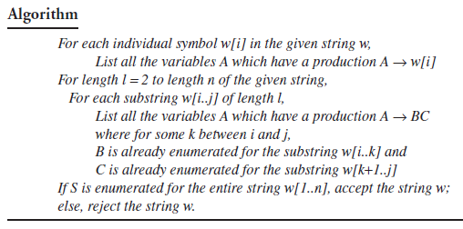
Parsing with CNF: CYK Algorithm

Slide 59
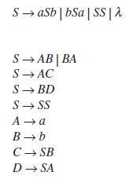
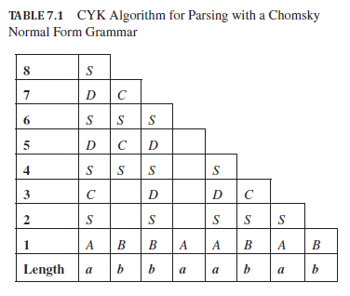
CYK Parsing: Example 23
Grammar:
CNF grammar:
Input string: abbaabab

Slide 60
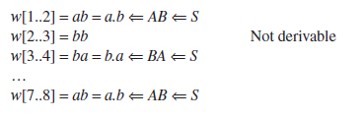
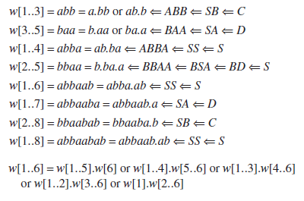
Filling CYK Table: Example 24 (contd..)

Slide 61
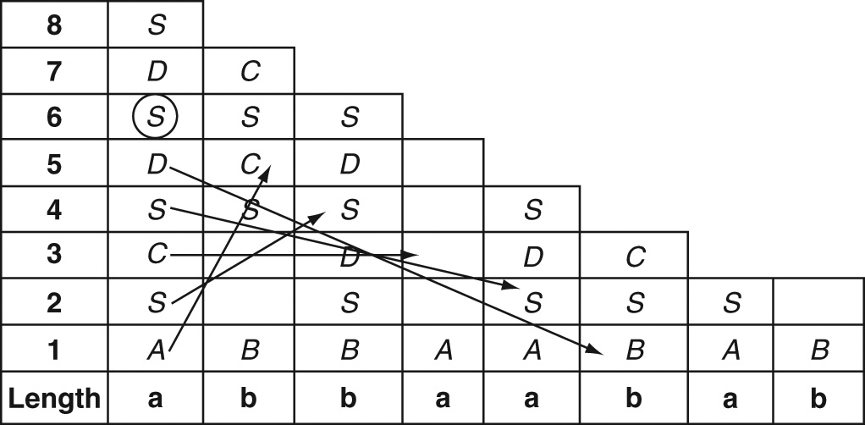
CYK Table–Filling: Pattern

Slide 62
The Idea of Greibach Normal Form
The idea of GNF is to make parsing linear, that is, every step in the derivation should introduce (or parse) exactly one terminal symbol from the input string.
With a grammar in GNF and a leftmost derivation, in each step, one more symbol, from left to right, is generated so that exactly n steps later, a string of length n is derived.
Every production in GNF looks like either of the following:
A → aBCD…
A → a
The leftmost symbol on the right–hand side of every production is a terminal symbol.
There cannot be any further terminal symbols in the production.
Instead, there can be zero or more non–terminals to the right of the terminal symbol.

Slide 63
Greibach Normal Form
In Greibach normal form, there are restrictions on the positions of terminal and variable symbols
A context-free grammar is in Greibach Normal Form if, in all of its productions, the right side consists of single terminal followed by any number of variables
The grammar below is in Greibach normal form
S → aAB | bBB | bB
A → aA| bB | b
B → b

Slide 64
Transforming a Grammar into Greibach Normal Form
For any context-free grammar that does not generate λ, it is possible to find an equivalent grammar in Greibach normal form
Consider the grammar from example 6.10, which is clearly not in Greibach normal form
S → abSb | aa
After replacing terminal symbols with new variables and adding new productions (in red), the resulting grammar is
S → aBSB | aA
A → a
B → b

Slide 65
Converting to GNF: Example 25
Equal numbers of a s and b s
S → aSb | bSa | SS | λ
Converting to GNF, we get:
S → aSB | bSA Introducing variables A for a and B for b
A → a
B → b
S → aSBS | bSAS | λ Substituting for the first S from the above rules

Slide 66
Simple Grammars
All regular grammars are of course linear.
A good characteristic of linear grammars is that, since there is only one variable on the right–hand side of any production, the sentential form always contains just one variable (except when the entire string is generated and there are no variables). The parser needs to consider only productions for that one variable. This reduces the number of choices for the parser, thereby making parsing more efficient.
In general, inefficiency in parsing is caused by the number of production rules that can be applied to the present sentential form.
Even in a linear grammar, there are still multiple choices since there can be more than one production with the same variable on the left–hand side.
An effective way to reduce the number of choices is to ensure that each production rule being applied matches the “next” terminal symbol in the input string to be generated or parsed.
For example, GNF ensured that every production began with a terminal symbol. A production can be applied in parsing with GNF only if its terminal symbol matches the next symbol in the input string.

Slide 67
Simple Grammars (contd..)
For example, if the current sentential form is aaSBB and the complete input string is aabbaab and the available productions for S are as follows:
S → aSB Next input symbol must be a: NOT APPLICABLE
S → bSA Next input symbol must be b: APPLICABLE
In GNF, there can still be more than one production rule that matches a given sentential form (even in a leftmost derivation).
This choice is eliminated in a stricter type of grammar known as simple grammar or s–grammar in which, for a given variable T and given terminal symbol a, there can be only one production rule of the type T → aXYZ.
There is also a sub–class of CFGs known as deterministic context–free grammars (see Chapter 11, Sec. 11.12).

Slide 68
Simple Grammars (contd..)
A context–free grammar G = (V, T, P, S) is said to be a simple grammar or s–grammar if all its productions are of the form
A → ax,
where A ∈ V, a ∈ T, x ∈ V*, and any pair (A, a) occurs at most once in P.
The grammar
S → aS | bSS | λ
is an s–grammar.
The grammar
S → aS | bSS | aSS | λ
is not an s–grammar because the pair (S, a) occurs in the two productions S → aS and S → aSS.

Slide 69
Theorems
Theorem 11: Substitution rule for Grammars: If a grammar has a set of productions:
A → uBv and B → x | y | z
where u, v, x, y, z stand for any piece of a sentential form with terminal and non–terminal symbols, then the grammar obtained by eliminating the B productions by substituting the right–hand sides of those productions wherever B occurs in other productions is equivalent to the original grammar:
A → uxv | uyv | uzv
Theorem 12: Equivalence of cleaned–up grammars: The grammar obtained by eliminating λ–productions, unit productions and useless variables from a context–free grammar is equivalent to the original grammar.
Theorem 13: Chomsky Normal Form: Every context–free grammar whose language does not contain λ can be converted to an equivalent grammar that is in Chomsky Normal Form.
Theorem 14: Greibach Normal Form: Every context–free grammar whose language does not contain λ can be converted to an equivalent grammar that is in Greibach Normal Form.

Slide 70
Summary
Context–free behavior arises when an action is taken irrespective of the surrounding context. A context–free language is one in which the occurrence or behavior of a symbol or pattern in a string is independent of other symbols or patterns to its left or right.
A context–free language is the language of a context–free grammar.
A context–free grammar is one in which every production rule has a single non–terminal and no other symbol on its left–hand side.
A production in a context–free grammar can be applied during parsing or derivation to a non–terminal in the sentential form without regard to other symbols in the sentential form.

Slide 71
Summary(contd..)
Context–free grammars are more powerful than regular grammars. They can derive languages that are not regular.
A linear context–free grammar has only zero or one non–terminal on the right–hand side of every production rule. However, such a grammar may not be right–linear or left–linear. Non–regular linear grammars can derive languages such as palindromes and the simple nesting language.
Other context–free languages require non–linear grammars with production rules that have more than one non–terminal on their right–hand sides. The typical pattern SS is used to generate languages such as proper nesting, nested if–then–else statements and arithmetic expressions in programming languages.
A context–free grammar is said to be ambiguous if it produces two different leftmost (or two different rightmost) derivations for the same string.
Often, an ambiguous grammar can be converted to an unambiguous grammar by introducing additional variables.
A language is said to be inherently ambiguous if every grammar for the language is ambiguous.

Slide 72
Summary(contd..)
Grammars can be cleaned up by eliminating λ–productions, unit productions and useless (i.e., non–generating or unreachable) variables.
A context–free grammar can be converted to Chomsky Normal Form in which every production is in one of two forms: A → a or A → BC. The idea is to ensure that the application of a production during derivation either eliminates a non–terminal by replacing it by a terminal symbol or grows the sentential form by exactly one symbol. This results in a binary parse tree.
The CYK algorithm can be applied to a grammar in Chomsky Normal Form to determine if a given string is grammatical, that is, belongs to the language of the grammar. Book–keeping in the CYK algorithm is made easy by applying a table–filling technique.

Slide 73
Summary(contd..)
The idea of a Greibach Normal Form is to ensure that every step in parsing consumes exactly one terminal symbol. Productions in this form have exactly one terminal symbol followed by zero or more non–terminals on their right–hand sides.
Simple grammars and other variations are used to reduce ambiguity and make parsing more efficient. Such context–free grammars are used extensively in the design of programming languages and compilers.
Although there is no algorithm to design a context–free grammar, the set of mantras discussed in the chapter help us in designing an accurate grammar for a given problem.

Slide 74
Learning Objectives At the conclusion of the chapter, the student will be able to:
Describe the components of a nondeterministic pushdown automaton
State whether an input string is accepted by a nondeterministic pushdown automaton
Construct a pushdown automaton to accept a specific language
Given a context-free grammar in Greibach normal form, construct the corresponding pushdown automaton
Describe the differences between deterministic and nondeterministic pushdown automata
Describe the differences between deterministic and general context-free languages

Slide 75
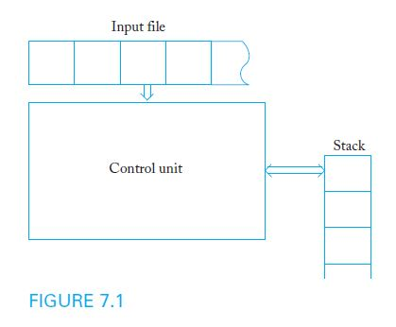
Nondeterministic Pushdown Automata
A pushdown automaton is a model of computation designed to process context-free languages
Pushdown automata use a stack as storage mechanism

Slide 76
Nondeterministic Pushdown Automata
A nondeterministic pushdown accepter (npda) is defined by:
A finite set of states Q
An input alphabet Σ
A stack alphabet Γ
A transition function δ
An initial state q₀
A stack start symbol z
A set of final states F
Input to the transition function δ consists of a triple consisting of a state, input symbol (or λ), and the symbol at the top of stack
Output of δ consists of a new state and new top of stack
Transitions can be used to model common stack operations

Slide 77
Sample npda Transitions
Example 7.1 presents the sample transition rule:
δ(q₁, a, b) = {(q₂, cd), (q₃, λ)}
According to this rule, when the control unit is in state q₁, the input symbol is a, and the top of the stack is b, two moves are possible:
New state is q₂ and the symbols cd replace b on the stack
New state is q₃ and b is simply removed from the stack
If a particular transition is not defined, the corresponding (state, symbol, stack top) configuration represents a dead state

Slide 78
A Sample Nondeterministic Pushdown Accepter
Example 7.2: Consider the npda
Q = { q₀, q₁, q_{2,} q₃ }, Σ = { a, b }, Γ= { 0, 1 }, z = 0, F = {q₃}
with initial state q₀ and transition function given by:
δ(q₀, a, 0) = { (q_{1,} 10), (q₃, λ) }
δ(q₀, λ, 0) = { (q₃, λ) }
δ(q₁, a, 1) = { (q_{1,} 11) }
δ(q₁, b, 1) = { (q_{2,} λ) }
δ(q₂, b, 1) = { (q_{2,} λ) }
δ(q₂, λ, 0) = { (q₃, λ) }
As long as the control unit is in q₁, a 1 is pushed onto the stack when an a is read
The first b causes control to shift to q₂, which removes a symbol from the stack whenever a b is read

Slide 79
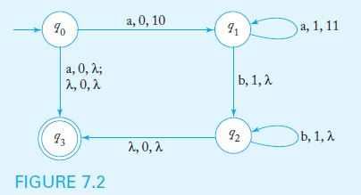
Transition Graphs
In the transition graph for a npda, each edge is labeled with the input symbol, the stack top, and the string that replaces the top of the stack
The graph below represents the npda in Example 7.2:

Slide 80
Instantaneous Descriptions
To trace the operation of a npda, we must keep track of the current state of the control unit, the stack contents, and the unread part of the input string
An instantaneous description is a triplet (q, w, u) that describes state, unread input symbols, and stack contents (with the top as the leftmost symbol)
A move is denoted by the symbol ˫
A partial trace of the npda in Example 7.2 with input string ab is
(q₀, ab, 0) ˫ (q₁, b, 10) ˫ (q₂, λ, 0) ˫ (q₃, λ, λ)

Slide 81
The Language Accepted by a Pushdown Automaton
The language accepted by a npda is the set of all strings that cause the npda to halt in a final state, after starting in q₀ with an empty stack.
The final contents of the stack are irrelevant
As was the case with nondeterministic automata, the string is accepted if any of the computations cause the npda to halt in a final state
The npda in example 7.2 accepts the language
{a^{n}b^{n}: n ≥ 0} ∪ { a }

Slide 82
Pushdown Automata and Context-Free Languages
Theorem 7.1 states that, for any context-free language L, there is a npda to recognize L
Assuming that the language is generated by a context-free grammar in Greibach normal form, the constructive proof provides an algorithm that can be used to build the corresponding npda
The resulting npda simulates grammar derivations by keeping variables on the stack while making sure that the input symbol matches the terminal on the right side of the production

Slide 83
Construction of a Npda from a Grammar in Greibach Normal Form
The npda has Q = { q₀, q₁, q_{F} }, input alphabet equal to the grammar terminal symbols, and stack alphabet equal to the grammar variables
The transition function contains the following:
A rule that pushes S on the stack and switches control to q₁ without consuming input
For every production of the form A → aX, a rule
δ (q₁, a, A) = (q₁, X)
A rule that switches the control unit to the final state when there is no more input and the stack is empty

Slide 84
Sample Construction of a NPDA from a Grammar
Example 7.6 presents the grammar below, in Greibach normal form
S → aSA | a
A → bB
B → b
The corresponding npda has Q = { q₀, q₁, q₂ } with initial state q₀ and final state q₂
The start symbol S is placed on the stack with the transition
δ(q₀, λ, z) = { (q₁, Sz) }
The grammar productions are simulated with the transitions
δ(q₁, a, S) = { (q_{1,} SA), (q_{1,} λ) }
δ(q₁, b, A) = { (q_{1,} B) }
δ(q₁, b, B) = { (q_{1,} λ) }
A final transition places the control unit in its final state when the stack is empty
δ(q₁, λ, z) = { (q₂, λ) }

Slide 85
Deterministic Pushdown Automata
A deterministic pushdown accepter (dpda) never has a choice in its move
Restrictions on dpda transitions:
Any (state, symbol, stack top) configuration may have at most one (state, stack top) transition definition
If the dpda defines a transition for a particular (state, λ, stack top) configuration, there can be no input-consuming transitions out of state s with a at the top of the stack
Unlike the case for finite automata, a λ-transition does not necessarily mean the automaton is nondeterministic

Slide 86
Example of a Deterministic Pushdown Automaton
Example 7.10 presents a dpda to accept the language
L = { a^{n}b^{n}: n ≥ 0 }
The dpda has Q = { q₀, q₁, q₂ }, input alphabet { a, b }, stack alphabet { 0, 1 }, z = 0, and q₀ as its initial and final state
The transition rules are
δ(q₀, a, 0) = { (q₁, 10) }
δ(q₁, a, 1) = { (q_{1,} 11) }
δ(q₁, b, 1) = { (q_{2,} λ) }
δ(q₂, b, 1) = { (q_{2,} λ) }
δ(q₂, λ, 0) = { (q_{0,} λ) }

Slide 87
Deterministic Context-Free Languages
A context-free language L is deterministic if there is a dpda to accept L
Sample deterministic context-free languages:
{ a^{n}b^{n}: n ≥ 0 }
{ wxw^{R}: w ∈ {a, b}*}
Deterministic and nondeterministic pushdown automata are not equivalent: there are some context-free languages for which no dpda can be built

Slide 88
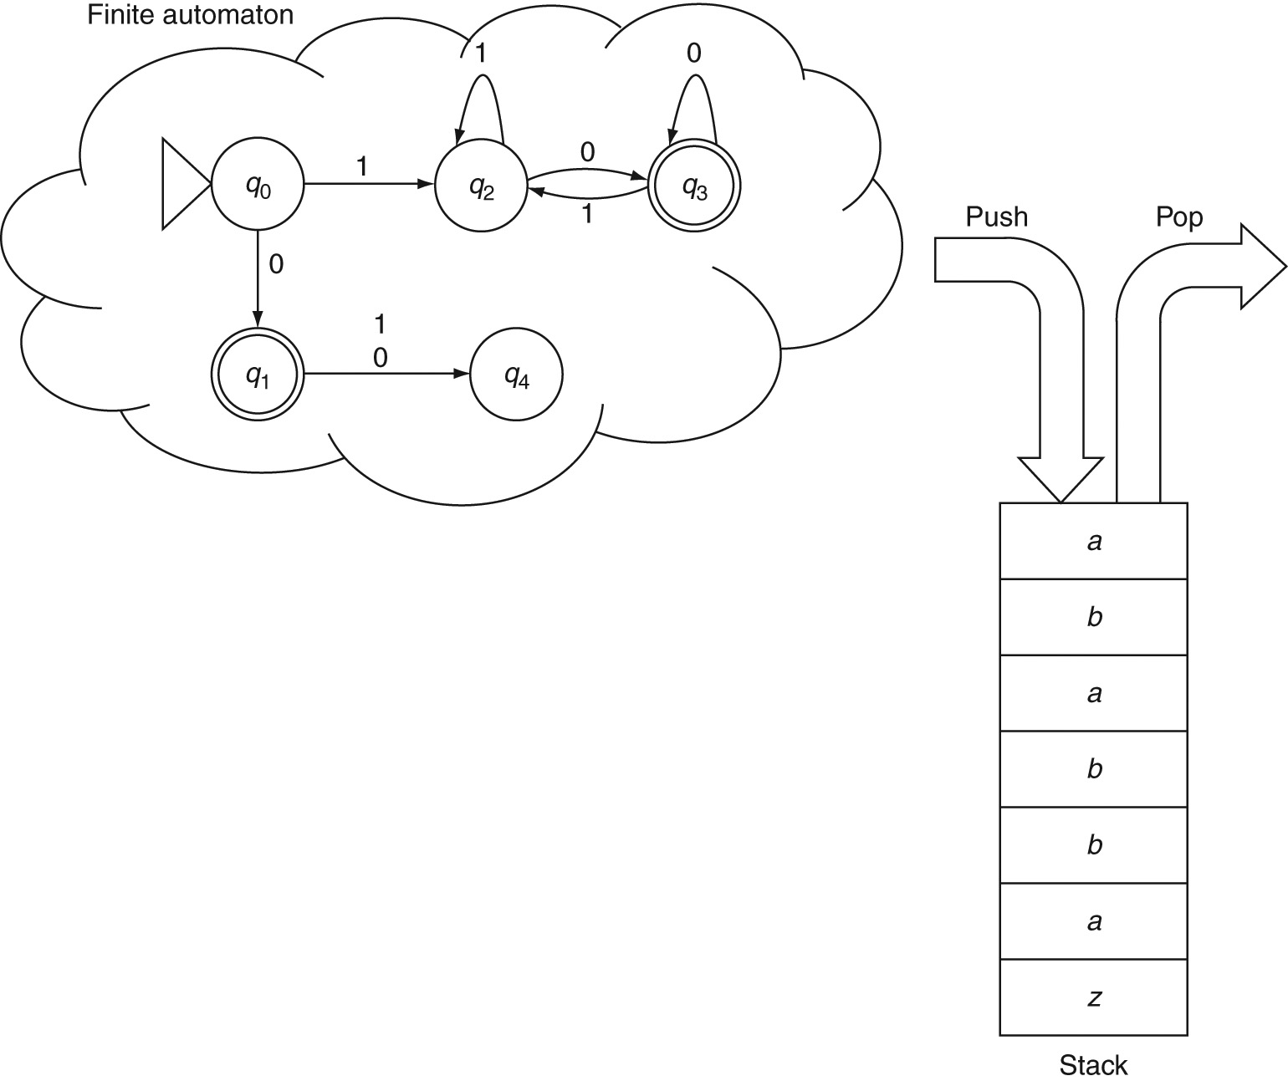
Pushdown Automaton

Slide 89
Elements of a Pushdown Automaton
A pushdown-automaton (PDA) M has 7 elements:
M.alphabet: Denoted by Σ, the input alphabet is the set of symbols present in input strings.
M.stackAlphabet: Denoted by Τ, the stack alphabet is the set of symbols used for storing on the stack. This set may or may not be the same as the input alphabet.
M.states: Also denoted by Q, it is the finite set of all states in the automaton.
M.startState: Usually denoted by q₀, it is the start state of the automaton.
M.finalStates: Denoted by Q_{F}, it is the subset of M.states that are final or accepting states of the automaton.
M.transitionFunction: This is a function δ from Q X Σ X Τ to Q X (POP) X (Τ), that is, a mapping from the current state, the current input symbol and the current symbol at the top of the stack, to a new state, an optional pop operation on the stack and a stack symbol that is optionally pushed onto the stack.
M.bottomOfStack: Usually denoted by z, it is a special symbol that is assumed to be always present at the bottom of the stack.

Slide 90
Operations of a PDA
Start with q₀ as the current state and z as the only symbol on the stack.
Examine the next input symbol reading it from left-to-right in a single pass. Examine the current symbol at the top of the stack.
Based on the input symbol, the current state and the stack symbol, find one or more matching transitions.
Execute the transition by:
consuming the input symbol,
moving to the new state as specified by the transition function,
popping the symbol on the top of the stack if so specified by the transition function and
pushing the symbol specified in the transition (if any) onto the stack.

Slide 91
Language of a PDA
When the input symbols are exhausted, if the machine is in a final state and if the stack is empty (i.e., if the symbol at the top of the stack is z), then we say the machine has accepted the input string. Otherwise, the machine rejects the input string.
The set of all strings over the alphabet that a PDA accepts is called the language of the machine (denoted by M.language).
The snapshot or instantaneous description or configuration of a PDA at a particular step during a computation can be captured by including the contents of its stack, the current state of the automaton, and the remaining part of the input string. For example the configuration
(q₃, abb, ABB)
means that the current state is q₃, input symbols remaining to be processed are abb and the current stack contents are ABB, A being the symbol on the top of the stack. Based on our convention, it is understood that the bottom-of-stack symbol z is present below these three stack symbols.

Slide 92
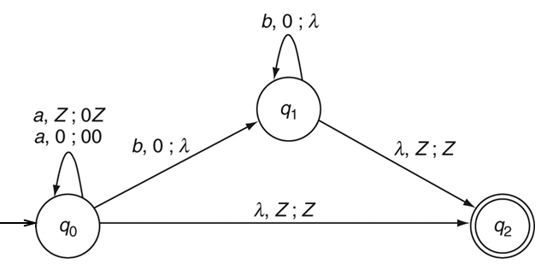
Constructing a PDA: Example 1
The language of simple nesting or a^{n}b^{n}

Slide 93
Constructing a PDA: Example 2
Nested if-else statements

Slide 94
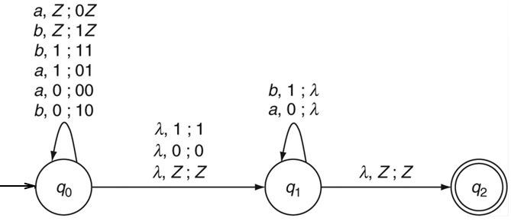
Constructing a PDA: Example 3
Non-deterministic PDA for even palindromes

Slide 95
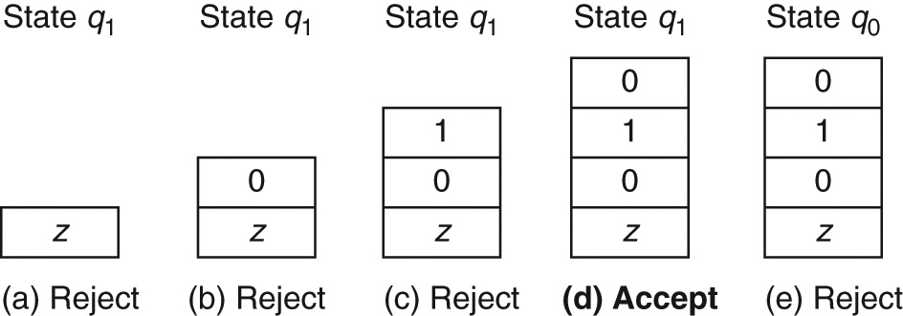
Example : Stack Contents
Possible configurations after processing aba in the input abaaba

Slide 96
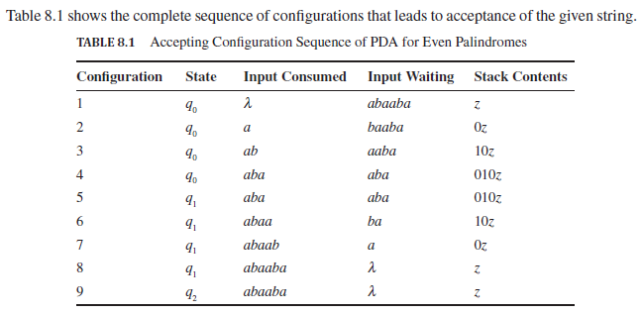
Example 3: Accepting Configuration

Slide 97
Summary for Constructing PDAs
What is a context-free grammar for the language?
What parts of strings in the language are correlated?
When do we introduce a new state?
How is it different from known languages?
Are any parts of strings in the language regular?
Do we need non-determinism?

Slide 98
Mantras for PDAs (contd..)
All the other mantras that we have been using from Chapter 2 are useful in constructing PDAs as well:
What is the simplest string in the language?
Is the null string a member of the language?
What are the patterns at the beginnings and ends of strings in the language?
What does the machine need to remember (through states and through the stack, in the case of a PDA)?
Do we have all the possible transitions from all the states for all the inputs symbols?
What is the complement of the language? What does the machine need to reject?
Do we need an explicit reject state?
Is the language the union of multiple sub-languages so that they can be handled in parallel branches?

Slide 99
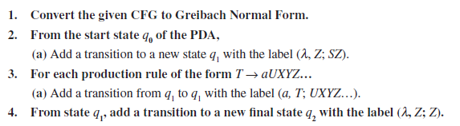
Converting CFG to PDA

Slide 100
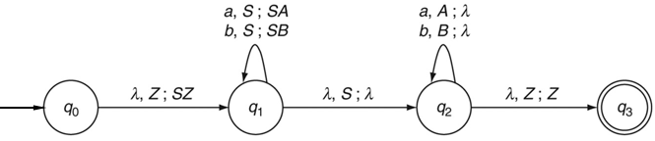
CFG to PDA: Example 4
Even palindromes
Grammar: S → aSa | bSb | λ
Greibach Normal Form
S → aSA | bSB | λ
A → a
B → b

Slide 101
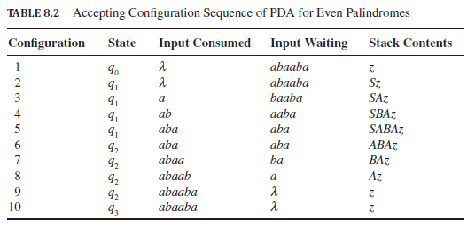
Example 4: Accepting Configuration

Slide 102
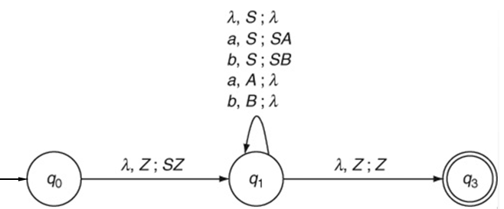
Another PDA for Example 4

Slide 103
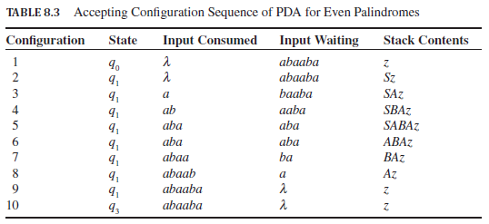
Another Accepting Sequence: Example 4

Slide 104
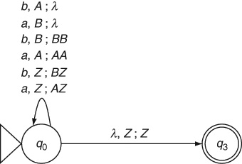
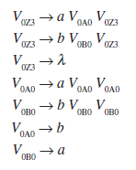

Converting PDA to CFG: Example 5
Equal numbers of a and b
CFG

Slide 105
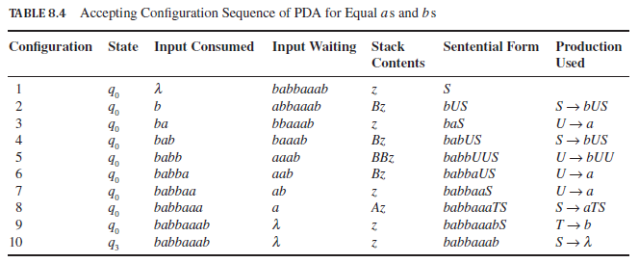
Example 5: Accepting Configuration

Slide 106
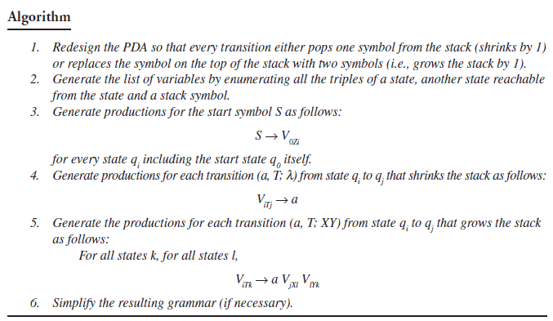
PDA to CFG: Algorithm

Slide 107
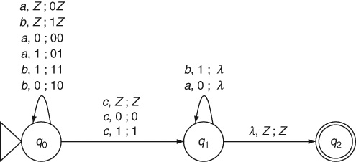
Deterministic PDA: Example 6
The language of odd palindromes, wcw^{R}

Slide 108
Theorems
Theorem 15: Equivalence of Nondeterministic PDA and CFL: The language of every nondeterministic pushdown automaton is a context-free language. Conversely, for every CFL, there is an equivalent NPDA that accepts the language.

Slide 109
Summary
A memory unit is added to a finite automaton to overcome its limitations of not being able to count or remember a sequence of input symbols.
Adding a memory unit that behaves like a stack data structure to a finite automaton gives us a pushdown automaton.
The stack memory is supposed to be of unlimited size although the number of states in the pushdown automaton must still be finite. There is no reason to limit the memory size of a PDA and thereby eliminate some input strings from being accepted.
The language of a pushdown automaton is a context-free language.
Context-free languages require the PDA to be non-deterministic. A deterministic PDA cannot handle languages such as even palindromes that require guessing the midpoint of the input string non-deterministically.
Context-free grammars and pushdown automata are equivalent.

Slide 110
Summary(contd..)
A grammar in Greibach Normal Form can be used to convert it to an equivalent pushdown automaton. The terminal symbol in the production rule matches the next input symbol and the non-terminal symbol on the left-hand side of the production is popped off the stack to be replaced by the non-terminals on the right-hand side.
A pushdown automaton can be converted to an equivalent context-free grammar although the resulting grammar is often unreadable.
Deterministic pushdown automata can only handle deterministic context-free languages which are a proper subset of context-free languages.
Although there is no algorithm to design a pushdown automaton, the set of mantras discussed in this chapter help us in designing an accurate PDA for a given problem.

Slide 111
Learning Objectives At the conclusion of the chapter, the student will be able to:
Apply the pumping lemma to show that a language is not context-free
State the closure properties applicable to context-free languages
Prove that context-free languages are closed under union, concatenation, and star-closure
Prove that context-free languages are not closed under either intersection or complementation
Describe a membership algorithm for context-free languages
Describe an algorithm to determine if a context-free language is empty
Describe an algorithm to determine if a context-free language is infinite

Slide 112
A Pumping Lemma for Context-Free Languages
Theorem 8.1: Given an infinite context-free language L, every sufficiently long string w in L can be broken into four parts uvxyz such that
|vy| ≥ 1
|vxy| ≤ m (where m is an arbitrary integer ≤ |w|)
An arbitrary, but equal number of repetitions of v and y yields another string in L
The “pumped” string consists of two separate parts (v and y) and can occur anywhere in the string
The pumping lemma can be used to show that, by contradiction, a certain language is not context-free

Slide 113
Pumping Lemma for CFLs
In plain English: Context-free languages are context-free because every non-trivial string in every infinite context-free language (that is not regular) has two correlated repeating patterns at least one of which is not empty and the two patterns are not too far from each other; these two patterns can be repeated in equal numbers any number of times to generate infinitely many strings in the language.
Formally: Every infinite context-free language L has a constant m, specific to that language, such that all strings w, |w| ≥ m belonging to L can be split into w = uvxyz, where |vxy| ≤ m and |vy| ≥ 1 and for all i = 0, 1, 2, ..., the strings uv^{i}xy^{i}z belong to L.

Slide 114
Why is the Pumping Lemma True?
Consider a leftmost derivation of a long string using a Greibach Normal Form grammar for the language. In such a derivation:
there is no limit on the length of the input string;
there is no limit on the depth of the derivation tree;
there is no limit on the length of the path from a leaf node to S in the derivation tree;
but there is a finite number of variables in the grammar, and thus,
there must be at least one repeated variable along the path.
The productions used at the different occurrences of the repeated variable can be interchanged according to the grammar to either collapse or pull out and expand the derivation tree. This is what is called pumping on i in the Pumping Lemma for CFLs.

Slide 115
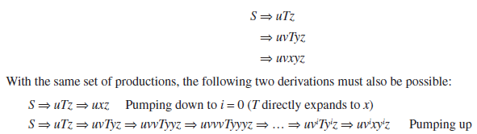
Why Pumping Lemma (contd..)
The resulting five parts of the yield of the tree are u, v, x, y and z.
u is the part derived by everything before the repeating variable T;
v is the part generated by T before repeating itself;
x is the part generated by T finally when it stops reappearing;
y is the part that is generated by T after repeating itself;
z is the part generated by everything after T.

Slide 116
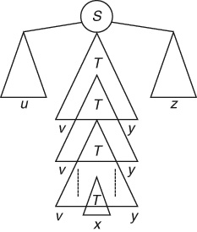
Why Pumping Lemma (contd..)

Slide 117
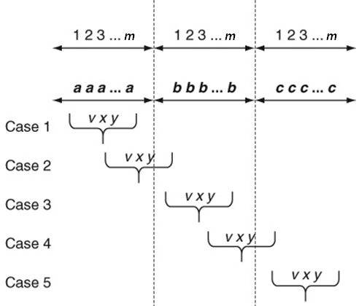
Using Pumping Lemma: Example 1
We cannot construct a CFG or PDA for a language such as a^{n}b^{n}c^{n}
Now let us prove that this language is not context-free. In a proof by contradiction using the Pumping Lemma, choose w = a^{m}b^{m}c^{m}
Possible Cases:

Slide 118
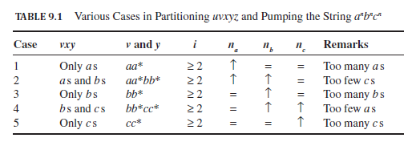
Pumping Lemma: Example 1 (contd..)

Slide 119

Pumping Lemma: Example 2
To show that ww is not context-free:

Slide 120

Pumping Lemma: Example 3
The formal language of multiplication is not a context-free language.
a^{p}b^{q}c^{r} where r = p x q
Choose w = a^{m}b^{m}c^{m x m}

Slide 121

An Illustration of the Pumping Lemma for Context-Free Languages
As shown in Figure 8.1, the pumping lemma for context-free languages can be illustrated by sketching a general derivation tree that shows a decomposition of the string into the required components

Slide 122
Closure Properties of CFG Pumping Lemma

Slide 123
Context-Free Languages: Closure Properties
Context-free languages (CFLs):
Languages of non-deterministic pushdown automata
Languages of context-free grammars
Closure Properties of CFLs:
Union of two CFLs is a CFL
By combining two CFGs: S → S₁ | S₂
Concatenation of two CFLs is a CFL
By combining two CFGs: S → S₁S₂
* Closure of a CFL is a CFL
By adding S → SS₁ | S₁ | λ

Slide 124
CFLs are NOT Closed Under…
Complementation: The complement of a context-free language may not be a context-free language.
Intersection: The intersection of two context-free languages may not be a context-free language.
Set difference: The set difference of two context-free languages may not be a context-free language.
However, the intersection of a context-free language and a regular language is context-free.
Homomorphism is replacing symbols in strings with new symbols.

Slide 125
Example: Complement of a CFL
Subset of a*b*c* where either the number of a s is not equal to the number of b s or the number of b s is not equal to the number of c s (i.e., n_{a} ≠ n_{b} or n_{b} ≠ n_{c}).
This is a CFL since we can write a CFG for it:
S → S₁ | S₂
S₁ → S₃ | S₄ | S₁c | c
S₃ → aS₃ | aS₃b | a
S₄ → S₄b | aS₄b | b
S₂ → S₅ | S₆ | aS₂ | a
S₅ → bS₅ | bS₅c | b
S₆ → S₆c | bS₆c | c
The complement of this language, however, is the language a^{n}b^{n}c^{n} which is not a CFL.

Slide 126

Example: Complement of a CFL
Complement of a CFL may not be a CFL

Slide 127
Closure Properties for Context-Free Languages
Theorem 8.3 states that if L₁ and L₂ are context-free languages, so are the languages that result from the following operations:
L₁ ∪ L₂
L₁ ∩ L₂
L₁*
In other words, the family of regular languages is closed under union, intersection, and star-closure.
To prove these properties, we assume the existence of two context-free grammars G₁ and G₂ that generate the respective languages

Slide 128
Proof of Closure under Union
Assume that L₁ and L₂ are generated by the context-free grammars G₁ = (V₁, T₁, S₁, P₁) and G₂ = (V₂, T₂, S₂, P₂)
Without loss of generality, assume that the sets V₁ and V₂ are disjoint
Create a new variable S₃ which is not in V₁ ∪ V₂
Construct a new grammar G₃ = (V₃, T₃, S₃, P₃) so that
V₃ = V₁ ∪ V₂ ∪ { S₃ }
T₃ = T₁ ∪ T₂
P₃ = P₁ ∪ P₂
Add to P₃ a production that allows the new start symbol to derive either of the start symbols for L₁ and L₂
S₃ → S₁ | S₂
Clearly, G₃ is context-free and generates the union of L₁ and L₂ , thus completing the proof

Slide 129
Proof of Closure under Concatenation
Assume that L₁ and L₂ are generated by the context-free grammars G₁ = (V₁, T₁, S₁, P₁) and G₂ = (V₂, T₂, S₂, P₂)
Without loss of generality, assume that the sets V₁ and V₂ are disjoint
Create a new variable S₄ which is not in V₁ ∪ V₂
Construct a new grammar G₄ = (V₄, T₄, S₄, P₄) so that
V₄ = V₁ ∪ V₂ ∪ { S₄ }
T₄ = T₁ ∪ T₂
P₄ = P₁ ∪ P₂
Add to P₄ a production that allows the new start symbol to derive the concatenation of the start symbols for L₁ and L₂
S₄ → S₁S₂
Clearly, G₄ is context-free and generates the concatenation of L₁ and L₂ , thus completing the proof

Slide 130
Proof of Closure under Star-Closure
Assume that L₁ is generated by the context-free grammars G₁ = (V₁, T₁, S₁, P₁)
Create a new variable S₅ which is not in V₁
Construct a new grammar G₅ = (V₅, T₅, S₅, P₅) so that
V₅ = V₁ ∪ { S₅ }
T₅ = T₁
P₅ = P₁
Add to P₅ a production that allows the new start symbol S₅ to derive the repetition of the start symbol for L₁ any number of times
S₅ → S₁S₅ | λ
Clearly, G₅ is context-free and generates the star-closure of L₁, thus completing the proof

Slide 131
No Closure under Intersection
Unlike regular languages, the intersection of two context-free languages L₁ and L₂ does not necessarily produce a context-free language
As a counterexample, consider the context-free languages
L₁ = { a^{n}b^{n}c^{m}: n ≥ 0, m ≥ 0 }
L₂ = { a^{n}b^{m}c^{m}: n ≥ 0, m ≥ 0 }
However, the intersection L₁ and L₂ is the language
L₃ = { a^{n}b^{n}c^{n}: n ≥ 0 }
L₃ can be shown not be context-free by applying the pumping lemma for context-free languages

Slide 132

No Closure under Complementation
The complement of a context-free language L₁ does not necessarily produce a context-free language
The proof is by contradiction: given two context-free languages L₁ and L₂, assume that their complements are also context-free
By Theorem 8.3, the union of the complements must also produce a context-free language L₃
Using our assumption, the complement of L₃ is also context-free
However, using the set identity below, we conclude that the complement of L₃ is the intersection of L₁ and L₂, which has been shown not to be context-free, thus contradicting our assumption.

Slide 133
Elementary Questions about Context-Free Languages
Given a context-free language L and an arbitrary string w, is there an algorithm to determine whether or not w is in L?
Given a context-free language L, is there an algorithm to determine if L is empty?
Given a context-free language L, is there an algorithm to determine if L is infinite?
Given two context-free grammars G₁ and G₂, is there an algorithm to determine if L(G₁) = L(G₂)?

Slide 134
A Membership Algorithm for Context-Free Languages
The combination of Theorems 5.2 and 6.5 confirms the existence of a membership algorithm for context-free languages
By Theorem 5.2, exhaustive parsing is guaranteed to give the correct result for any context-free grammar that contains neither λ-productions nor unit-productions
By Theorem 6.5, such a grammar can always be produced if the language does not include λ
Alternatively, a npda to accept the language can be constructed as established by Theorem 7.1

Slide 135
Determining Whether a Context-Free Language is Empty
Theorem 8.6 confirms the existence of an algorithm to determine if a context-free language L(G) is empty
For simplicity, assume that λ is not in L(G)
Apply the algorithm for removing useless symbols and productions
If the start symbol is found to be useless, then L(G) is empty; otherwise, L(G) contains at least one string

Slide 136
Determining Whether a Context-Free Language is Infinite
Theorem 8.7 confirms the existence of an algorithm to determine if a context-free language L(G) is infinite
Apply the algorithms for removing λ-productions, unit-productions, and useless productions
If G has a variable A for which there is a derivation that allows A to produce a sentential form xAy, then L(G) is infinite
Otherwise, L(G) is finite
Can be implemented by building a dependency graph which contains an edge from A to B for every rule of the form A → xBy

Slide 137
Determining Whether Two Context-Free Languages are Equal
Given two context-free grammars G₁ and G₂, is there an algorithm to determine if L(G₁) = L(G₂)?
If the languages are finite, the answer can be found by performing a string-by-string comparison
However, for general context-free languages, no algorithm exists to determine equality

Slide 138
Decidable Questions about CFLs
Is a given context-free language empty? That is, given a representation of the language in the form of a context-free grammar, is there any string that is generated by it or is the language a null set?
If S is useless, i.e., non-generating, then the language is empty
Example of a CFL whose language is empty:
S → aA | bB | C
A → aA | Ab | bB
B → bB | Ba | aA
C → bA | aB | aSb | bSa
Is a given context-free language finite or Infinite? Infinite if products are cyclic.
Does a given string w belong to a context-free language L? This is called the membership question. We can apply the CYK algorithm to answer this.

Slide 139
Undecidable Questions about CFLs
There is no method (or algorithm) to answer the following:
Are two context-free languages the same?
No way to compare two CFGs
Is a given context-free language ambiguous?

Slide 140
Non-Context-Free Languages
Languages such as a^{n}b^{n}c^{n} and ww are not context-free.
Why?
They involve types of counting or matching that is not possible with the single stack of a pushdown automaton
They involve coordinating the derivation of two or more parts of the sentential form which is not possible in a context-free grammar
Pumping lemma for CFLs helps us show that such languages are not context-free.

Slide 141
Theorems
Theorem 16: Closure properties of CFL: Context-free languages are closed under union, concatenation and *-closure.
Corollary 16.1: CFLs are not closed under complementation, intersection or set-difference.
Theorem 17: Pumping Lemma for CFL: Every infinite context-free language L has a constant m, specific to that language, such that all strings w, |w| ≥ m belonging to L can be split into w = uvxyz, where |vxy| ≤ m and |vy| ≥ 1 and for all i = 0, 1, 2, ..., the strings uv^{i}xy^{i}z belong to L.
Theorem 18: Ogden’s Lemma: Every infinite context-free language L has a constant m, specific to that language, such that all strings w, |w| ≥ m belonging to L can be marked (or distinguished) at any m or more symbols and split into w = uvxyz, where vxy has at most m marked symbols, vy contains at least one marked symbol and for all i = 0, 1, 2, ..., the strings uv^{i}xy^{i}z belong to L.
Theorem 19: Decidable Questions about CFL: Algorithms exist to determine if a given context-free language is empty, finite or infinite; an algorithm exists to determine if a given string belongs to the language of a given context-free grammar.

Slide 142
Summary
Combining context-free languages is not as simple as combining regular languages. Context-free languages are well-behaved only under the operations of union, concatenation and *-closure.
The complement of a context-free language or the intersection or set difference of two context-free languages may or may not be context-free.
A context-free language is empty if in any equivalent grammar, the start symbol S is non-generating.
A context-free language is finite if its grammar has no recursive production rule or cycle among any of its nonterminals.
Most other questions about context-free languages cannot be answered. Whether two context-free grammars have the same language or whether a given context-free language is ambiguous are undecidable questions. There can never be an algorithm to answer such questions about context-free languages!

Slide 143
Summary(contd..)
Every regular language is context-free.
There are languages that are not context-free.
A PDA can count or remember one sequence of symbols and match it with another sequence. However, in the process of matching, the PDA forgets the count by emptying its stack. If the language requires matching with a third sequence, for example, such a language is not context-free.
All infinite context-free languages have a pair of correlated repeating patterns that are not too far from each other.
The repeating patterns can together be repeated any number of times to generate an infinite set of strings each of which must belong to the context-free language. This is called the Pumping Lemma.
The Pumping Lemma is used only to show that a given language is not context-free in a proof by contradiction.

Slide 144
Summary (contd..)
The pumping lemma is used in an adversarial game where the opponent chooses an unknown value for the constant m and an unknown partition of the string w into uvxyz. We can choose the string w and the value of i to our convenience.
Application of the Pumping Lemma works like an adversarial game because of alternating universal and existential quantifiers. We are free to choose any value when a variable is universally quantified but must ensure that our arguments work for any unknown value when under an existential quantifier.
The key to a successful application of the pumping lemma is to choose a string that includes the constant m and takes full control over the crucial substring of length m.
Context-free grammars can generate strings with a pair of coordinated repeating patterns only if the two patterns mirror each other at opposite ends of strings. They are unable to deal with either more than two patterns, e.g., a^{n}b^{n}c^{n}, or with kinds of patterns that do not correspond to the behavior of a stack, e.g., ww.

